Slide 1
Test Cases, Test Suites and Test Case management systems
Astea Solutions QA Team
Why do we need such a thing?

Slide 2
Questions
Define the terms failure, fault, and error
What is defect masking?
Explain the difference between testing and debugging
List several misconceptions about testing
Why do we test

Slide 3
What is test case?

Slide 4
What is test case?
Document
Contains defined test conditions
preconditions for execution
input data
expected outputs or the expected behavior of the test object
Should have a high probability of revealing previously unknown faults

Slide 5
Why do we need to create test cases?
Requirements traceability
Structured way to verify customer needs are satisfied
Requirements traceability matrix
Shows the relationship between requirements and test cases
Table that shows many to many relationships
No full names are displayed - it is just a summary
When a requirement is changed
Notes:
Which requirement is applied in which test cases and which test case tests which requirement

Slide 6
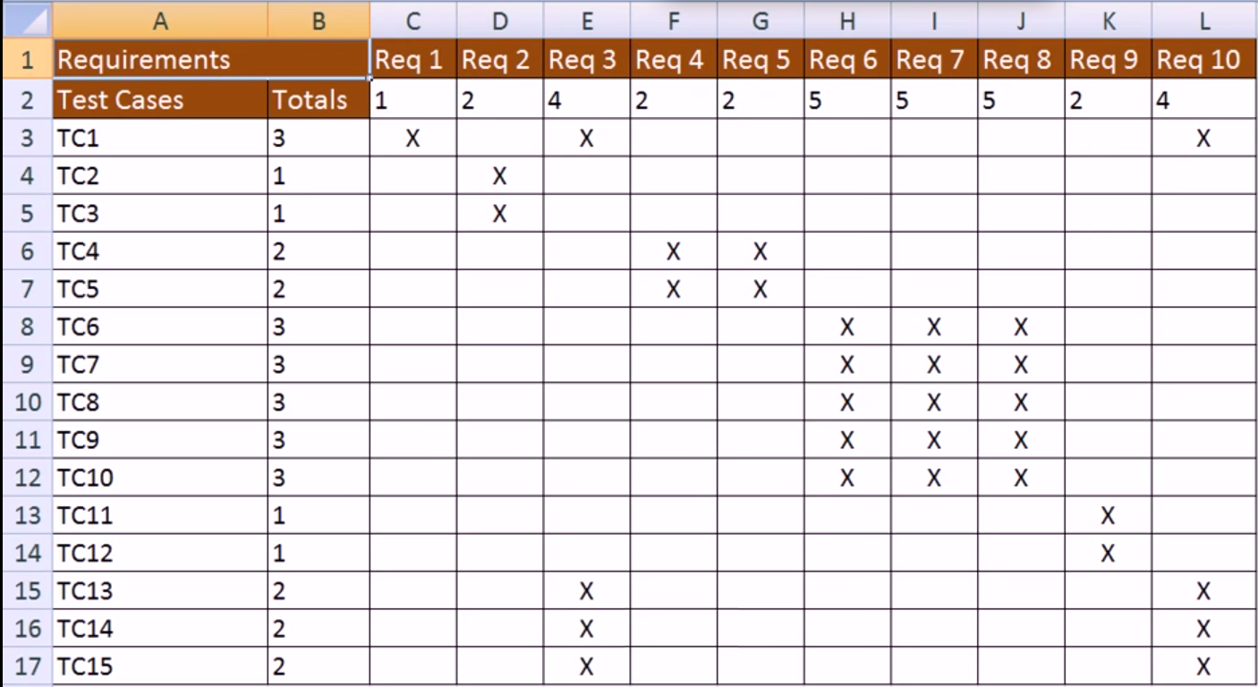
Requirements traceability matrix (RTM)
Notes:
Which requirement is applied in which test cases and which test case tests which requirement

Slide 7
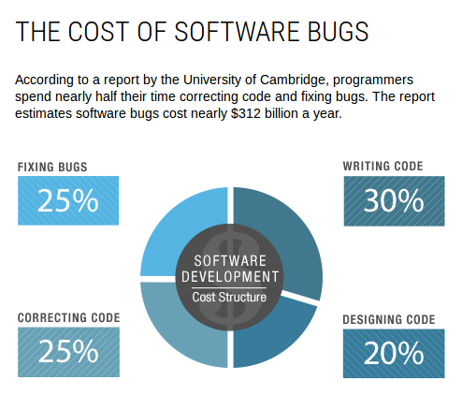
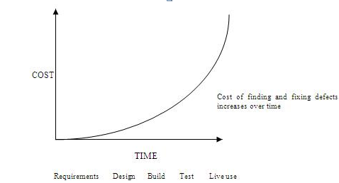
Why do we need to create test cases(2)
Testing SHOULD start as early as possible!
Early bug detection

Slide 8
Why do we need to create test cases(3)
Audit trail of testing done
Formal documentation what will be/was tested
Prove that some functionality is tested

Slide 9
Why do we need to create test cases(4)
Re-usability/Regression testing
Can be executed over and over on each iteration
Used for test automation
Regression testing - the process of testing changes to computer programs to make sure that the older programming still works with the new changes.

Slide 10
Why do we need to create test cases(5)
Knowledge transfer

Slide 11
Test case structure
ID
Name
Priority
Date/Author
Description
Preconditions
Test data
Steps
Expected result

Slide 12
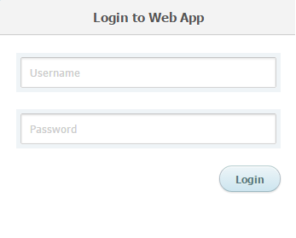
Test Case Demo
Test Case DeMo-1: Demo
Author: | admin
Summary: Log into the system
Preconditions: Google Chrome
#: | Step actions: | Expected Results:
1 | Enter “user1” in username field | “user1” is entered
2 | Enter “password1” in password field | “password1” is entered
3 | Click on “Login” button | User is successfully logged in
Execution type: | Manual
Keywords: | login

Slide 13
Test case types
By Details:
High level
Input data, steps and expected result are not specified
Each QA execute it differently and can find new bugs
Does not guarantee complete tests even of major functionality
Easy to maintain

Slide 14
High level test case demo
Test Case DeMo-2: High level demo
Author: | admin
Summary: Enter positive integer in age field and submit it
Preconditions: Google Chrome
#: | Step actions: | Expected Results:
1
Execution type: | Manual
Keywords:

Slide 15
Test case types (2)
By Details:
Low level
Detailed steps and expected result with given input data
Every QA will execute it exactly the same and will not miss regression
Narrows testers’ horizon and creativity
Hard to maintain

Slide 16
Low level test case demo
Test Case DeMo-3: Low level demo
Author: | admin
Summary: Here we will make a low level test
Preconditions: Google Chrome
#: | Step actions: | Expected Results:
1 | Enter 42 in the field | 42 is entered
2 | Click on Submit button | The data is submitted successfully
Execution type: | Manual
Keywords: | age

Slide 17
Test case types (3)
By Expected result:
Positive
Verify main functions are working correctly (best/happy path)
Verify cases of expected use
Ensure customers can achieve what product is designed for
Should always be performed

Slide 18
Positive test case demo
Test Case DeMo-4: Positive test demo
Author: | admin
Summary: Here we will make a positive test
Preconditions: Google Chrome
#: | Step actions: | Expected Results:
1 | Enter 42 in the field | 42 is entered
2 | Click on Submit button | The data is submitted successfully
Execution type: | Manual
Keywords: | age

Slide 19
Test case types (4)
By Expected result:
Negative
Verify system does not crash in case of invalid data
Verify customer will not get bad experience in case of incorrect or malicious usage
Should be performed in mission critical applications or products used by real customers

Slide 20
Negative test case demo
Test Case DeMo-5: Negative test demo
Author: | admin
Summary: Here we will make a negative test
Preconditions: Google Chrome
#: | Step actions: | Expected Results:
1 | Enter “abcd” in the field | “abcd” is entered
2 | Click on Submit button | Data is not submitted.
Execution type: | Manual
Keywords: | age

Slide 21
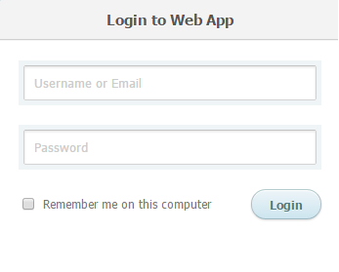

Slide 22
Test case execution and expected result
Test case execution is finished once we compare Actual vs. Expected results
PASS – Actual result corresponds to Expected result
FAIL – Actual result does not correspond to Expected result
Blocked – other bug prevents us from executing this test case
Best theoretical case: one expected result
Focus on only one thing while testing
The reality: many expected results
Each step can have one or more expected result
Keep number of expectations low (1-3)
Combine only related (to each other) expected results
Can distract the person executing the test case
Optimizes test effort

Slide 23
Test case maintainability
Maintainability - The readiness of a software product to be modified to correct defects, to meet new requirements, to make future maintenance easier, or to adapted to a changed environment
Software changes often and a lot
This requires changes (add, update, remove) in test cases
Design test case to be easily modified
Separate common steps in dedicated document – Knowledge base
Test case maintainability depends of its level of details
Do not add obvious or unrelated steps

Slide 24
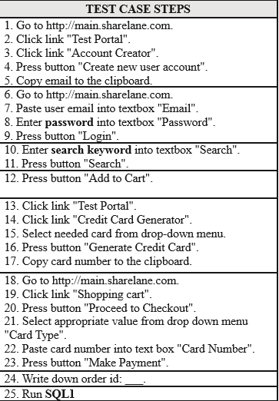
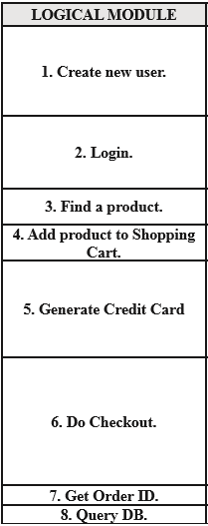
Test case maintainability

Slide 25
Bad practices
Dependency between test cases
Independent test case does not refer to another test case and does not rely on other test case to bring the system in certain state
Poor step description
Things clear and obvious now for you can become unclear in a month

Slide 26
Bad practices (2)
Poor expected result description
It should be clear what and why this is the expected result
Do not make references to an external documents
Everything works as expected
Long or complex test cases
Other people are going to execute your test cases !!!

Slide 27
Good practices
Stage of the project
High level test cases are preferred in early stages of the project
The more mature projects become and the more users are using it, the level of details and number of test cases increases
Always keep your test cases up to date
Test the simple stuff (if time permits) cases for specific part of the project or specification

Slide 28
Good practices (2)
Put yourself in the shoes of the end user

Slide 29
Good practices (2)
Put yourself in the shoes of the end user
Update test cases if new scenarios come to your mind
Importance of the project
Critical projects should be thoroughly tested
This implies detailed test cases covering different situations
Complexity of the project
Important projects are complex
Require more test data

Slide 30
Test suite
Combination of test cases that check specific part of the project or specification
Test cases and test suites are used to formally document test process
Structure:
Author
Spec ID
Developer
Priority (usually 1-4)
OVERVIEW – represents the IDEA of the test suite
Test cases – Execution result

Slide 31
Test Case management systems
Microsoft Excel
Testlink
Zephyr
QA Complete, HP Quality center etc.

Slide 32
TestLink
TestLink is a web based test management and test execution system. It enables quality assurance teams to create and manage their test cases as well as to organize them into test plans. These test plans allow team members to execute test cases and track test results dynamically.
Open Source Software

Slide 33
TestLink demo
https://oblacheto.com/testlink

Slide 34
Summary
What is a test case?
Test case structure?
Test case types?
Good and bad practices

Slide 35
Resources
https://github.com/TestLinkOpenSourceTRMS/testlink-code/raw/testlink_1_9/docs/testlink_user_manual.pdf

Slide 36
Homework
Go to https://oblacheto.com/testlink, register, create a test suite with your Faculty number and make 8 test cases (for an application/website of your choice):
2 high level positive test cases
2 high level negative test cases
2 low level positive test cases
2 low level negative test cases
Export the test suite and submit it in moodle

Slide 37
Questions

