Slide 1
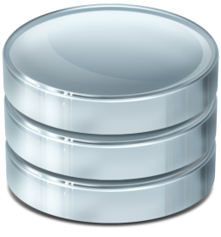
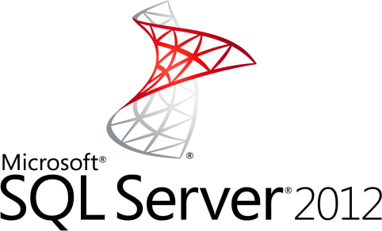
Introduction to SQL Server
Working with MS SQL Server and SQL Server Management Studio
SQL

Slide 2
Table of Contents
SQL Server Overview
SQL Server Services
Types of Databases
Authentication and Permissions
SQL Server Management Studio
Moving a SQL Server Database
Through Backups and Restore
By Detaching and Attaching

Slide 3
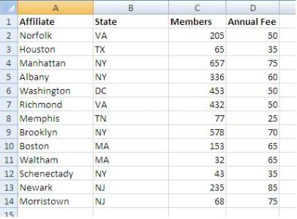
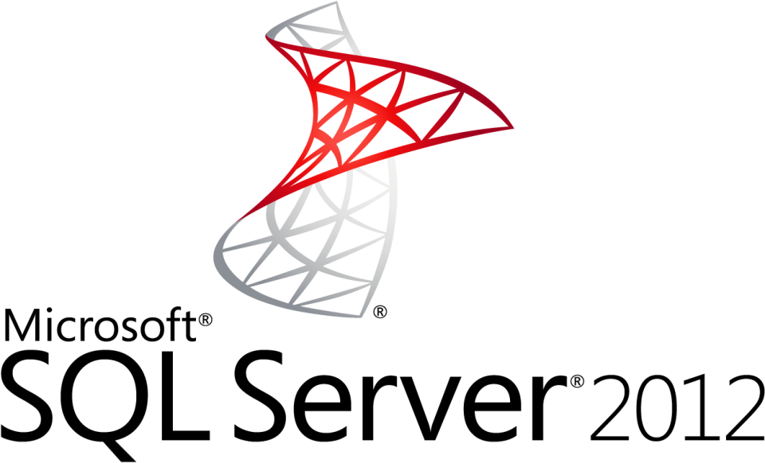
MS SQL Server
Overview

Slide 4
What is Microsoft SQL Server?
MS SQL Server
Relational Database Management System (RDBMS) from Microsoft
The main language in SQL Server
Transact SQL (T-SQL), an extension of SQL
Powerful, trustworthy, easy-to-use DB server
The most recent version is SQL Server 2014
Works only on Windows systems

Slide 5
How to Install SQL Server?
Download SQL Server 2014
SQL Server 2014 Express (free distribution)
http://www.microsoft.com/express/database/
DreamSpark – you can register with academic email

Slide 6
SQL Server Services
Background-Running Processes

Slide 7
Services of SQL Server 2012
SQL Server – the database engine
Responsible for database management, data storage, queries, data manipulation, data integrity, transactions, locking, users, security, etc.
Executes SQL / T-SQL queries
SQL Server Agent – DB monitoring
Executes scheduled tasks
Monitors the SQL Server
Sends notifications about problems

Slide 8
Services in SQL Server 2012 (2)
Distributed Transaction Coordinator (MSDTC)
Manages database transactions across multiple processes
Supports transactions that span multiple databases
Coordinates committing the distributed transaction across all the servers that are enlisted in the transaction
Implements 2-phase commit

Slide 9
SQL Server Databases
Northwind
msdb
tempdb
msdb

Slide 10
SQL Server Databases
SQL Server has system and user databases
System databases
Maintain internal information about MS SQL Server as a system
Don't play with them!
User databases
Databases created by users (developers)
Store user's schemas and data
Use the system databases internally

Slide 11
Types of SQL Server Databases
System Databases
master
model
tempdb
msdb
distribution
pubs
Northwind
…
User Databases

Slide 12
System Databases
Master – meta-database keeping data about
User accounts
Configurable environment variables
System error messages
Model – a prototype for new databases
Tempdb – storage for temporary tables and database objects
MSdb – alerts and scheduled tasks

Slide 13
SQL Server Databases
Each SQL Server database consists of two files:
.mdf file
Contains the core data in the database
Schema, tables data, and other database objects
.ldf file
Transaction log – keeps track of transactions
You need both these files to use the database

Slide 14
SQL Server Authentication
Users, Roles, Permissions

Slide 15
Connecting to SQL Server
Connecting to SQL Server requires
The name of the server (e.g. localhost)
The name of the DB instance (e.g. SQLEXPRESS)
The name of the database (e.g. Northwind)
Username / password (if using SQL Server authentication)
Types of authentication in SQL Server
Windows (by using a Windows user credentials)
Mixed (both Windows and SQL Server)

Slide 16
SQL Server Users Permissions
Each user has certain permissions and roles for a database (Database User Account)
A role defines a group of users with the same permissions
There are 3 types of roles in MS SQL Server
Fixed server roles
Fixed database roles
User-defined database roles

Slide 17
Fixed Database Roles
Public – maintains all default permissions for users in a database
Db_owner – performs any database role activity
Db_accessadmin – add or remove database users, groups, and roles
Db_ddladmin – add, modify, or drop database objects
Db_securityadmin – assign statement and object permissions
Others …

Slide 18
SQL Server Authentication
Live Demo

Slide 19
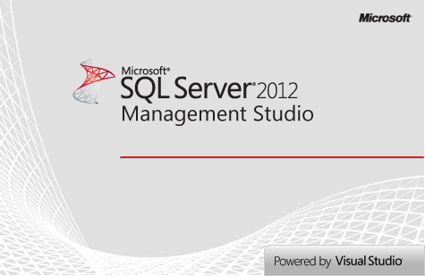
SQL Server Management Studio
A Powerful Management Tool for Administrators and Developers

Slide 20
SQL Server Management Studio (SSMS)
SQL Server Management Studio (SSMS) is a powerful graphical DB management tool
Administrate databases (create, modify, backup / restore DB)
Create and modify E/R diagrams
View / modify table data and other DB objects
Execute SQL queries
Free and easy to use tool
Works with all SQL Server versions

Slide 21
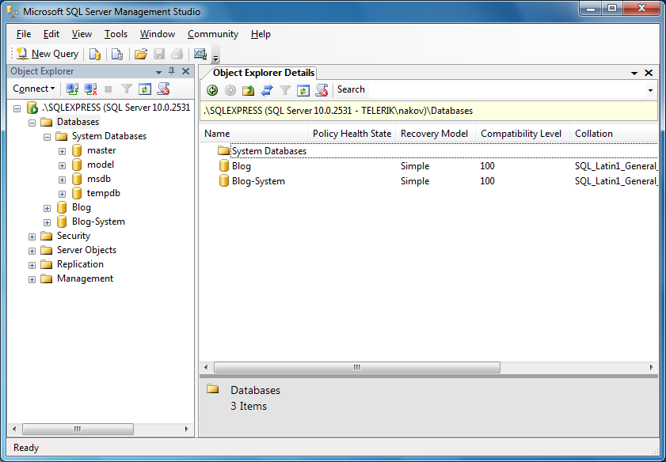
SQL Server Management Studio – Screenshot

Slide 22
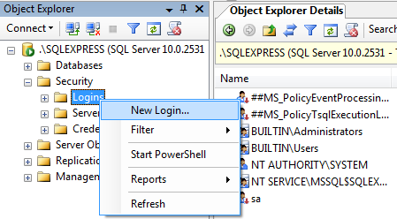
SSMS Setting Server Account
You can use SSMS to create database user / give permissions to Windows users
Follow these steps:
Right click on the [Security / Login] folder in Object Explorer and choose "New Login…"

Slide 23
SSMS Setting Server Account (2)
In the next dialog click the [Search] button
Select one of the Windows accounts in a typical Windows fashion
Leave the authentication method set to Windows authentication
Click [OK]
Thus you create an SQL Server User account
Account permissions could be assigned later
Windows administrators already have access

Slide 24
SSMS Setting Database Account
Right click on the "Security" under some of the databases and choose "New" → "User"
Enter username and select one of the Server accounts to use
Assign the roles for this user
Click [OK] to confirm
By selecting the [Name-of-Database] → "Properties" → "Permissions" you can also set specific permissions for the accounts

Slide 25
Creating Accounts and Assigning Permissions in SQL Server

Slide 26
Using SQL Server Management Studio
SSMS can be used to visually edit the structure or data in a database
It can execute T-SQL queries
Select the database you want to work with in the Object Explorer
Click the [New Query] button
Write the query in the window to the right of Object Explorer
Click the [Execute] button

Slide 27
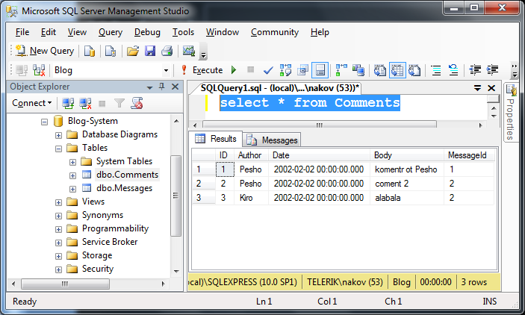
Executing SQL – Screenshot

Slide 28
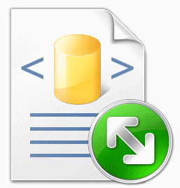
Executing Simple SQL Queries in SQL Server Management Studio

Slide 29
Moving an SQL Server Database
Backup / Restore, Detach / Attach

Slide 30
Moving a SQL Server Database
Necessary when we install a certain application at the customer environment
Ways of moving an SQL Server database:
By backup and restore
Create backup and restore it on the other server
By detaching and attaching the database files
The 2 servers must be the same versions!
By dumping the database as SQL script
Export the database to SQL script and import it into a new server

Slide 31
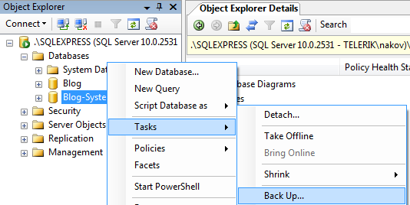
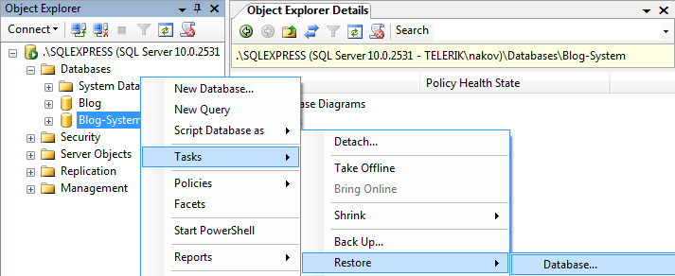
Moving DB by Backup and Restore
Backup and restore database through SSMS

Slide 32
Moving DB by Detaching and Attaching
On the source server:
Choose the database in SQL Server Management Studio
From the context menu we choose the Detach command
We copy the database files from the source server to the destination server:
<database_name>.mdf
<database_name>.ldf
Typical location: C:\Program Files\Microsoft SQL Server\MSSQL12.MSSQLSERVER\MSSQL\DATA

Slide 33
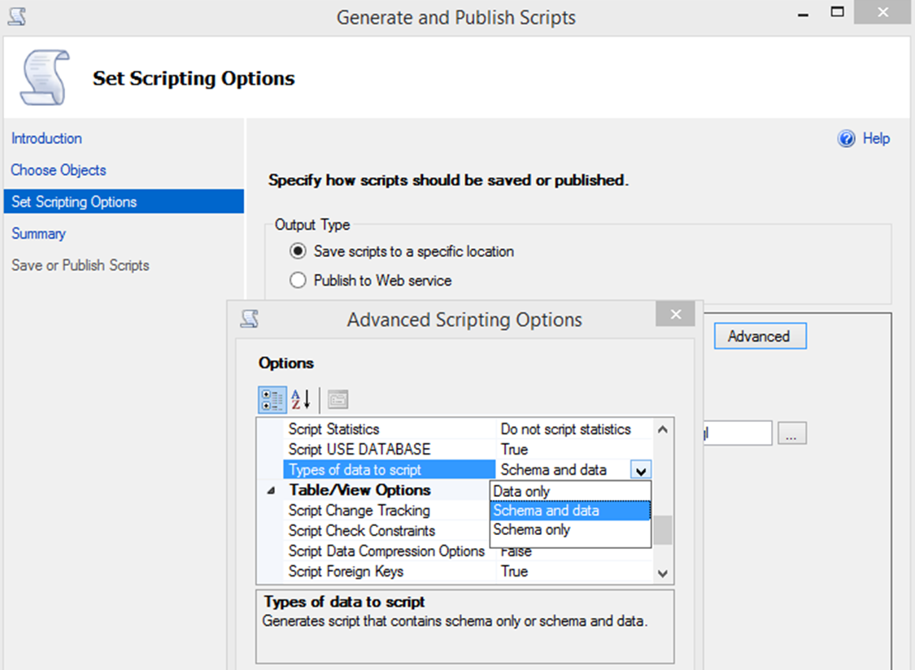
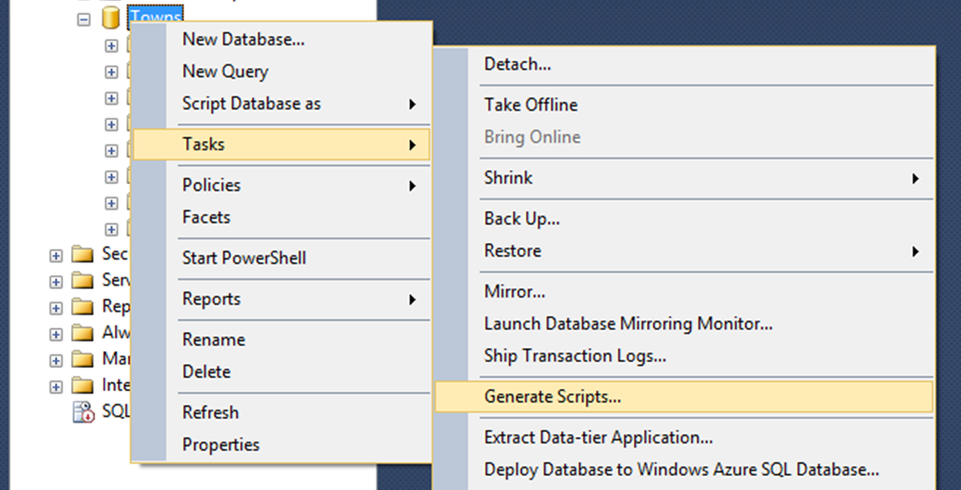
Moving DB by SQL Script Export / Import
Export a MS SQL database as SQL script
Database → Tasks → Generate Scripts
Advanced → Types of data to script → Schema and data

Slide 34
Moving a Database by Detaching and Attaching

Slide 35
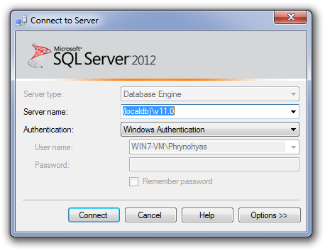
SQL Server LocalDB
Auto-Started MSQL Databases

Slide 36
SQL Server LocalDB
SQL Server Express LocalDB
Special version of SQL Server Express for developers
Lightweight, dynamically attachable MSSQL databases
Auto-started upon connection request
Console-based administration
List all LocalDB engine instances:
Start a LocalDB engine instance:
Stop a LocalDB engine instance:
sqllocaldb info
sqllocaldb start MSSQLLocalDB
sqllocaldb stop MSSQLLocalDB

Slide 37
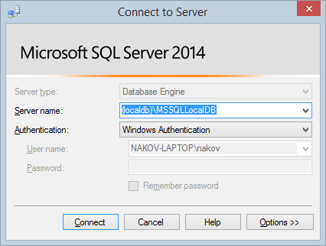
Connecting to SQL Server LocalDB
SQL Server LocalDB uses special connection strings:
SQL Server Express 2012 LocalDB:
SQL Server Express 2014 LocalDB:
The database engine is auto-started on demand (upon connection request)
(localdb)\v11.0
(localdb)\MSSQLLocalDB

Slide 38
SQL Server LocalDB

Slide 39
Summary
What is RDBMS?
What is the purpose of SQL Server Agent service?
What is MSdb?
Why we need the .ldf file?
How do we backup / restore a database?
How do we export a DB to SQL script?
How do we import a DB from a SQL script?
What is SQL Server Express LocalDB?
Databases

