Slide 1
Introduction to MySQL
Working with MySQL and MySQL Workbench

Slide 2
Table of Contents
MySQL Community Server
MySQL Services, Start, Stop
Authentication and Login
MySQL Console Client
MySQL Workbench
phpMyAdmin Tool
Create / Edit / Delete Databases and Tables
Import / Export a MySQL Database

Slide 3
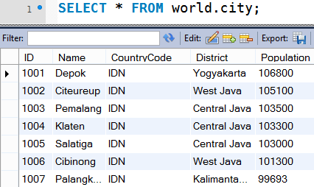
MySQL Server
Overview

Slide 4
What is MySQL?
MySQL Database Server
MySQL is open-source DB server (RDBMS)
World's most-popular open-source database
Mostly used to power web sites and small apps
Supports concurrency, transactions (full ACID)
Stored procedures, views, triggers, partitioning
Support clustering and replication
Free and paid editions
Community Server, Enterprise, Cluster CGE

Slide 5
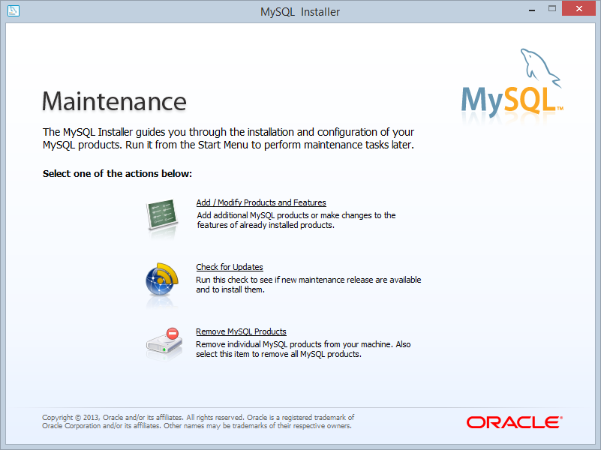
MySQL Community Server
MySQL Community Server
The free open-source MySQL edition
MySQL for Windows:
Pre-packaged installer available from http://dev.mysql.com/downloads/mysql/
MySQL for Linux:
Available through the package managers
sudo apt-get install mysql-server
(Debian / Ubuntu)
sudo yum install mysql-server
(Red Hat / CentOS)

Slide 6
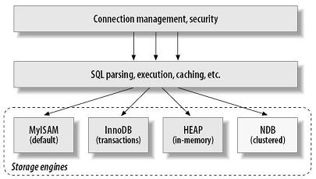
MySQL Storage Engines
InnoDB
Fully ACID transactional, highly reliable
Recommended for most applications
MyISAM
Fast, non-transactional, unreliable → forget it!
Memory (HEAP)
Ultra-fast, non-persistent storage (in-memory)
CSV
Stores the data in CSV (text) files (slow!)

Slide 7
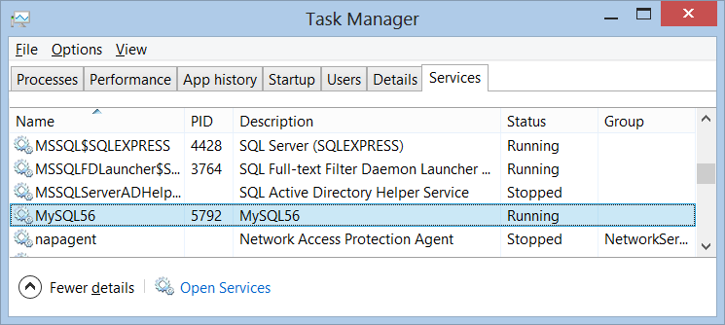
MySQL Services, Start, Stop
MySQL services in Windows
Just one service: MySQL56
Starting:
Stopping:
MySQL services in Linux
Starting:
Stopping:
net start MySQL56
net stop MySQL56
sudo service mysql start
sudo service mysql stop

Slide 8
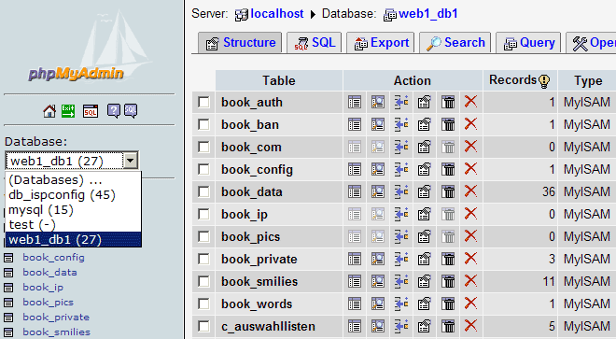
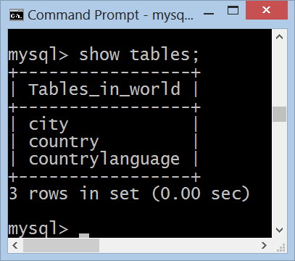
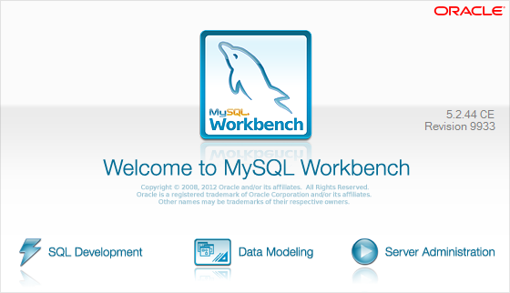
MySQL Administration Tools
The Console MySQL Client, MySQL Workbench, phpMyAdmin

Slide 9
Authentication and Login
MySQL uses traditional username / password authentication
The administrator's user is: root
The default password is specified during the installation process
Connecting through the console client
mysql –u root -p
use world;
select * from city limit 100;

Slide 10
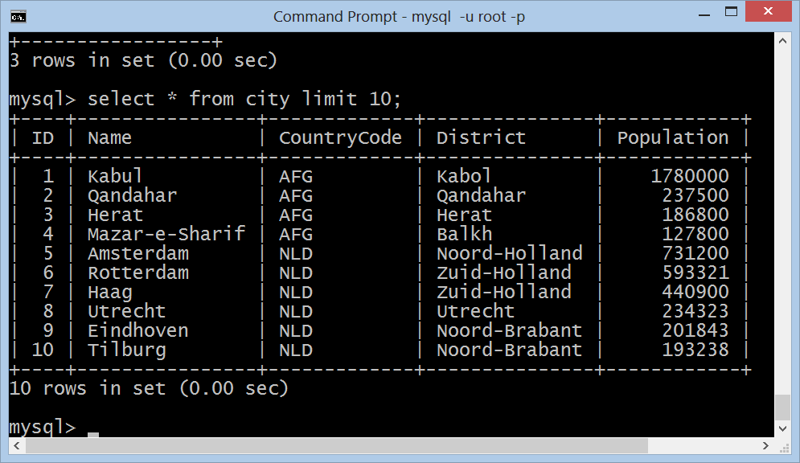
MySQL Console Client

Slide 11
MySQL Workbench
MySQL Workbench
Free open-source GUI administration tool for MySQL
Execute SQL queries
Browse / edit table data
Create / modify relational schema
DB design (E/R diagrams)
Forward / reverse engineering
Visualize query plan

Slide 12
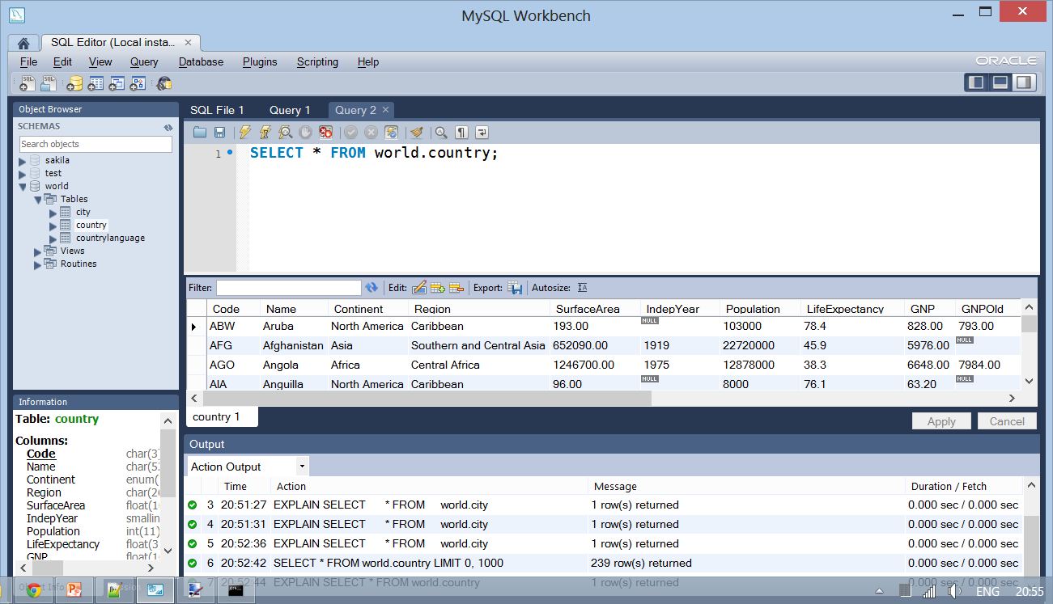
MySQL Workbench
Live Demo

Slide 13
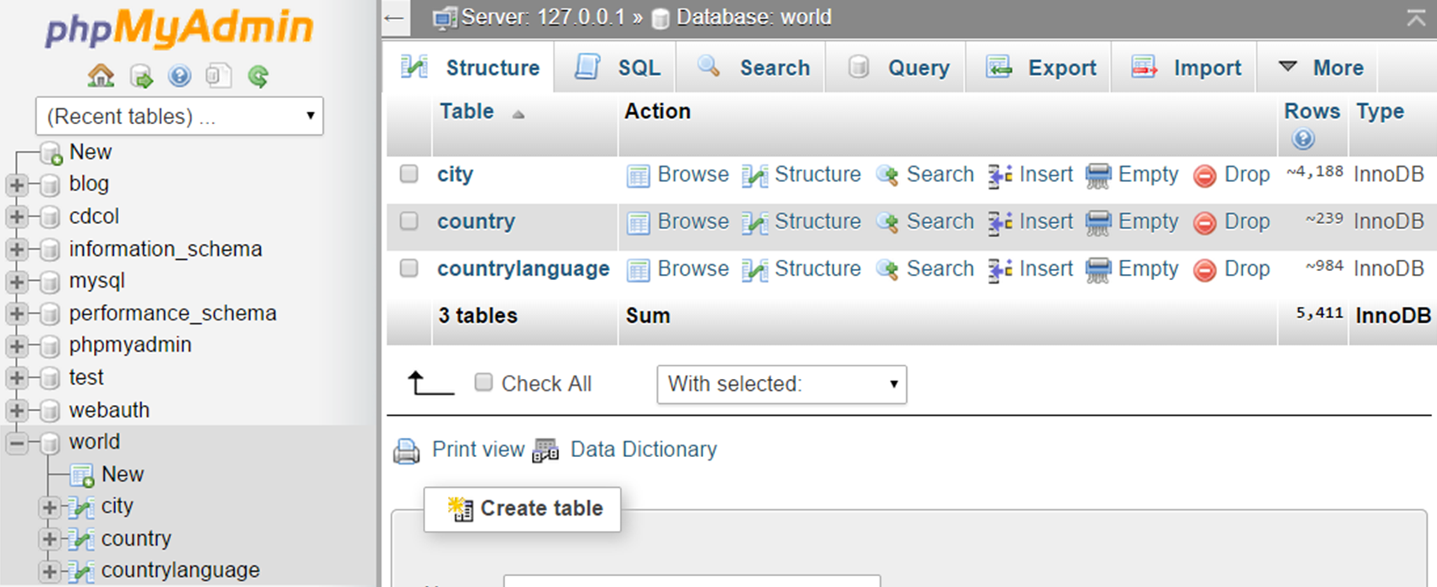
phpMyAdmin Tool
phpMyAdmin – Web-based open-source MySQL admin tool

Slide 14
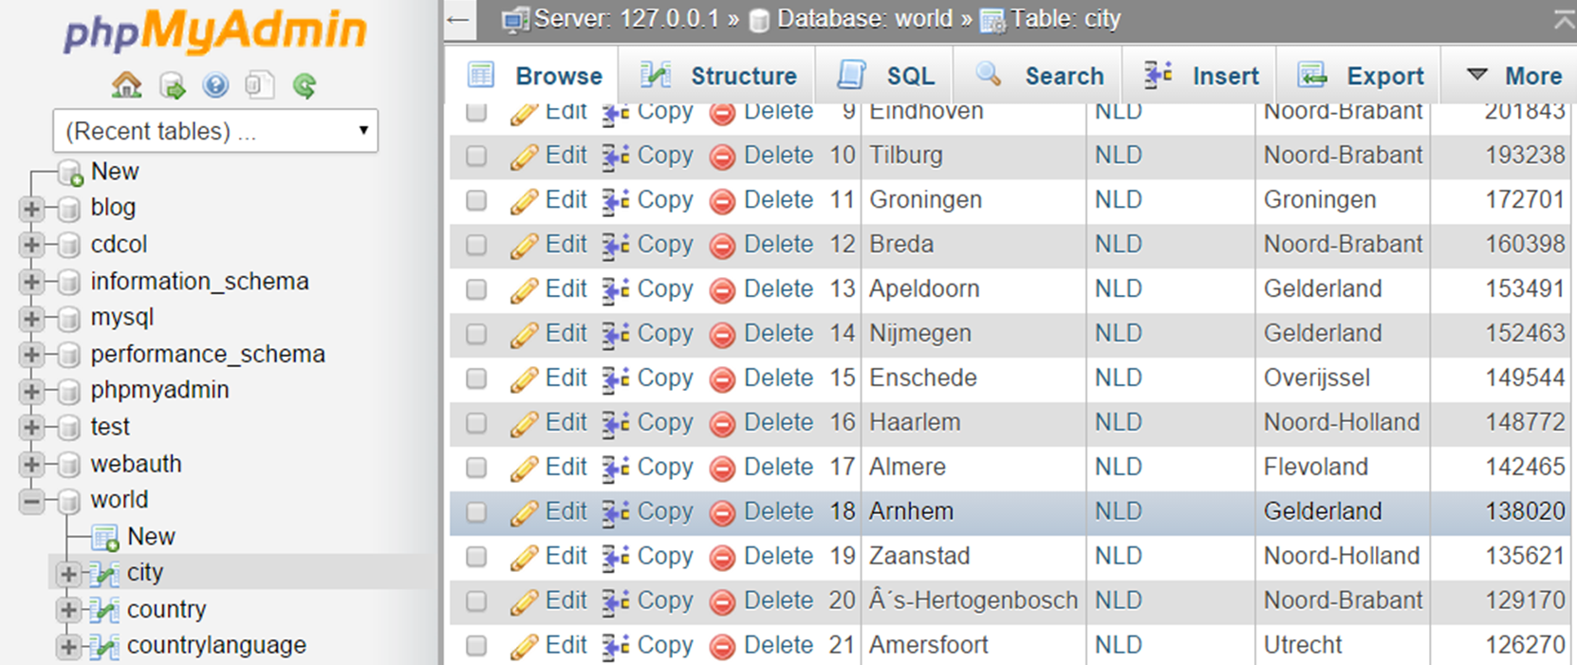
phpMyAdmin
Live Demo

Slide 15
Creating Databases and Tables
CREATE DATABASE books
Creating a database
Creating tables
USE books;
CREATE TABLE authors (
id INT NOT NULL AUTO_INCREMENT,
name VARCHAR(50) NOT NULL,
PRIMARY KEY (id)
);
CREATE TABLE books (
id INT NOT NULL AUTO_INCREMENT,
name VARCHAR(150) NOT NULL,
isbn VARCHAR(13) NULL,
PRIMARY KEY (id)
);

Slide 16
Edit Tables and Table Data
ALTER TABLE books ADD COLUMN author_id INT NULL AFTER isbn;
ALTER TABLE books ADD INDEX FK_books_authors_idx (author_id ASC);
ALTER TABLE books ADD CONSTRAINT FK_books_authors
FOREIGN KEY (author_id) REFERENCES authors (id);
Altering tables
Inserting data rows
INSERT INTO authors (name) VALUES ('Nakov');
INSERT INTO books (name, author_id, isbn)
VALUES ('Intro C#', 1, '9789544005276');

Slide 17
Moving a MySQL Database
To move MySQL database to another server
Use the SQL export / SQL import features
Export a database to SQL script
MySQL Workbench → Server Administration → Data Export → Export to Self-Contained File
phpMyAdmin → Export → SQL
Import a database from SQL script
Just execute the script in Workbench
phpMyAdmin → Import → SQL

Slide 18
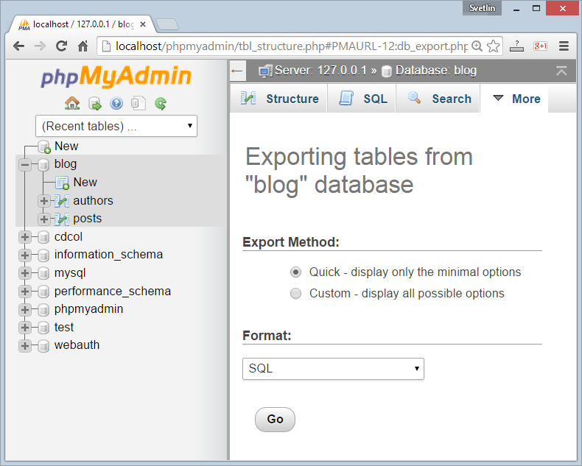
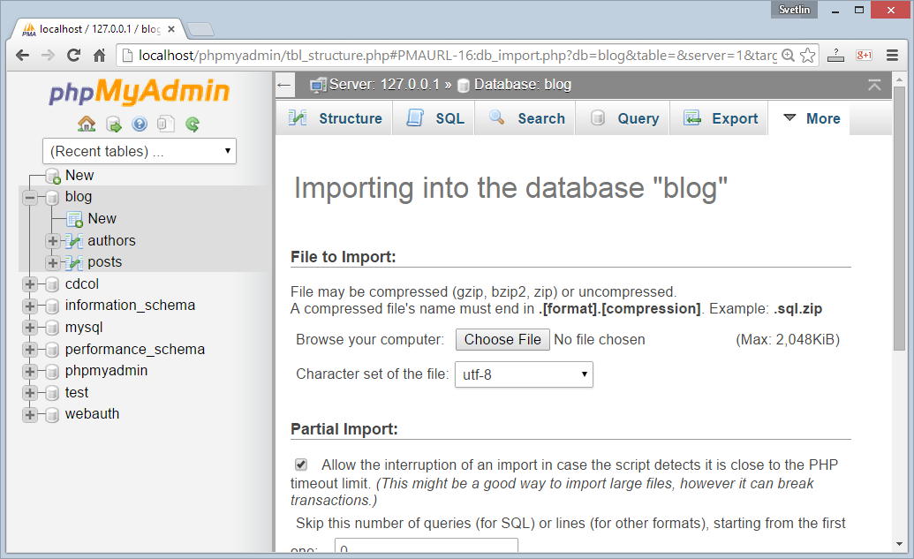
Import / Export MySQL Database

Slide 19
Summary
What is MySQL?
How to install MySQL?
Which MySQL storage engine is recommended for most Web applications?
What is MySQL Workbench? Pros and Cons?
What is phpMyAdmin? Pros and Cons?
How do you create a new DB schema?
How do you create a new table?
How do you move a MySQL DB to another server?
Databases

